Slide 1

Chapter 4: Logical Database Design and the Relational Model
Notes:
Chapter Overview
The purpose of this chapter is to describe in depth the major steps in logical database design, with emphasis on the relational model.
Logical database design is the process of transforming the conceptual data model (described in Chapters 2 and 3) into a logical data model.
First, we provide a concise description of the relational data model, including the properties of relations. Next, we describe and illustrate the various types of integrity constraints associated with the relational model.
This section introduces S Q L table definitions and the concept of well-structured relations. We then provide a detailed description of the process of transforming E E R diagrams into relations.

Slide 2
Objectives
Definition of terms
List five properties of relations
State two properties of candidate keys
Transform E-R and EER diagrams to relations
Create tables with entity and relational integrity constraints

Slide 3
Data Modeling
Conceptual Data Model
Enterprise Level
Project Level
Enhanced (EERD)
Logical Data Model
Physical
Relational Model

Slide 4
Components of Relational Model
Data structure
Tables (relations), rows, columns
Data manipulation
Powerful S Q L operations for creating and modifying structures, for retrieving and modifying data
Data integrity
Mechanisms for implementing business rules that maintain integrity of manipulated data

Slide 5
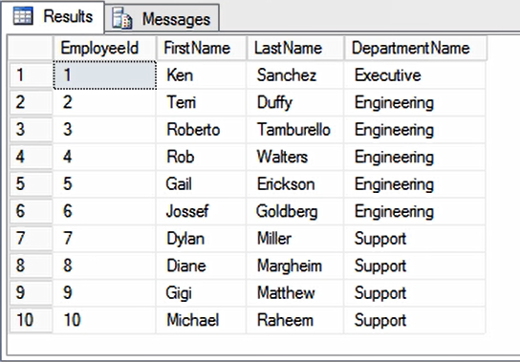
Relation
Employee
Definition: A relation is a named, two-dimensional table of data
Table consists of rows (records) and columns (attribute or field)
Requirements for a table to qualify as a relation:
Notes:
Definition: A relation is table. It has a name, it has columns, and it has rows.
Requirements for a table to qualify as a relation:
It must have a unique name
Every attribute value must be atomic (not multivalued, not composite) -> think about excel, if you have more than one data point inside of the same cell, it is not atomic
Every row must be unique (can’t have two rows with exactly the same values for all their fields)
Attributes (columns) in tables must have unique names
The order of the columns must be irrelevant
The order of the rows must be irrelevant

Slide 6
Relation Requirements
It must have a unique name
Every attribute value must be atomic (not multivalued, not composite)
Every row must be unique (can’t have two rows with the same values for all their fields)
Attributes (columns) in tables must have unique names
The order of the columns must be irrelevant
The order of the rows must be irrelevant

Slide 7
Is this a relation?
Employee
EmployeeID | First Name | Last Name | Department | Date Hired
1 | John | Smith | Accounting | 7/3/1990
2 | Derek | Rose | Customer Service | 8/9/1996
3 | Monica | Lynn | IT | 3/7/1961
2 | Derek | Rose | Customer Service | 8/9/1996
Notes:
No, duplicate row

Slide 8
Is this a relation?
Employee
EmployeeID | First Name | First Name | Department | Date Hired
1 | John | Smith | Accounting | 7/3/1990
2 | Derek | Rose | Customer Service | 8/9/1996
3 | Monica | Lynn | IT | 3/7/1961
4 | Jonathan | Fernandes | Customer Service | 8/9/1993
Notes:
No, duplicate columns

Slide 9
Is this a relation?
EmployeeID | First Name | Last Name | Department | Date Hired
1 | John | Smith | Accounting | 7/3/1990
2 | Derek | Rose | Customer Service | 8/9/1996
3 | Monica | Lynn | IT | 3/7/1961
4 | Jonathan | Fernandes | Customer Service | 8/9/1993
Notes:
No, no table name

Slide 10
Correspondence with E-R Model
Relations (tables) correspond with entity types and with many-to-many relationship types
Rows correspond with entity instances and with many-to-many relationship instances
Columns correspond with attributes
NOTE: The word relation (in relational database) is NOT the same as the word relationship (in E-R model)
Notes:
From E-R diagram, all entity's gets translated to tables, also, many to many

Slide 11
Key Fields
Keys are special fields that serve two main purposes:
Primary keys are unique identifiers of the relation in question. Examples include employee numbers, social security numbers, etc. This is how we can guarantee that all rows are unique
Foreign keys are identifiers that enable a dependent relation (on the many side of a relationship) to refer to its parent relation (on the one side of the relationship)
Keys can be simple (a single field) or composite (more than one field)
Keys usually are used as indexes to speed up the response to user queries (More on this in Chapter 6)

Slide 12
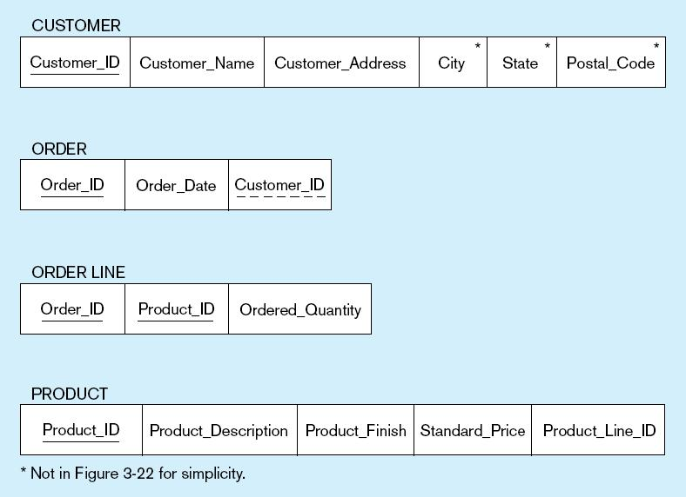
Figure 5-3 Schema for four relations (Pine Valley Furniture Company)
Primary Key
Foreign Key (implements 1:N relationship between customer and order)
Combined, these are a composite primary key (uniquely identifies the order line)…individually they are foreign keys (implement M:N relationship between order and product)

Slide 13
Integrity Constraints
Domain Constraints
Allowable values for an attribute (includes data types and restrictions on values)
Entity Integrity
No primary key attribute may be null. All primary key fields MUST contain data values.
Referential Integrity
Rules that maintain consistency between the rows of two related tables.

Slide 14
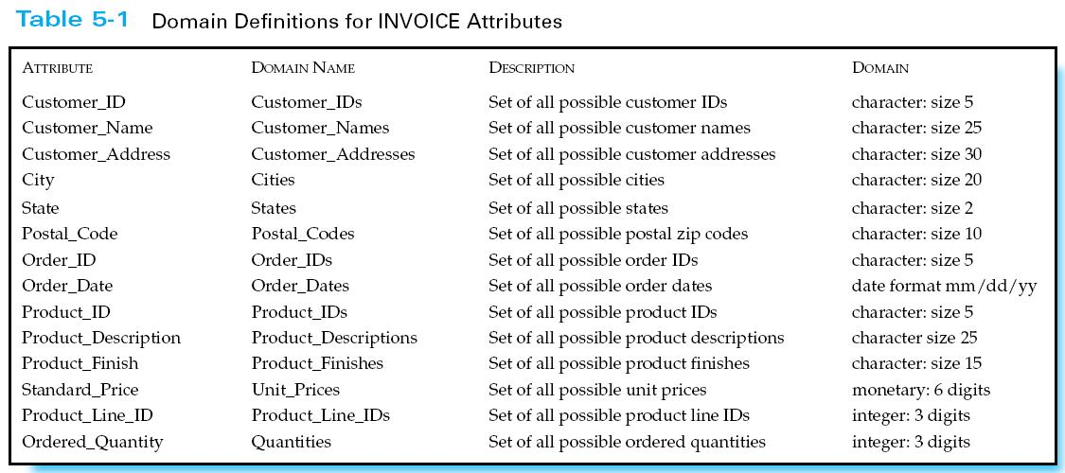
Domain definitions enforce domain integrity constraints
Notes:
Domain constraints are enforced through database definitions.

Slide 15
Integrity Constraints
Referential Integrity–rule states that any foreign key value (on the relation of the many side) MUST match a primary key value in the relation of the one side. (Or the foreign key can be null)
For example: Delete Rules
Restrict–don’t allow delete of “employee” side if related rows exist in “dependent” side
Cascade–automatically delete “dependent” side rows that correspond with the “employee” side row to be deleted
Set-to-Null–set the foreign key in the dependent side to null if deleting from the parent side → not allowed for weak entities
Notes:
Draw Example of customer order
Integrity constraint enforces the primary key FK relationship.
When deleting, you can either restrict., cascade

Slide 16
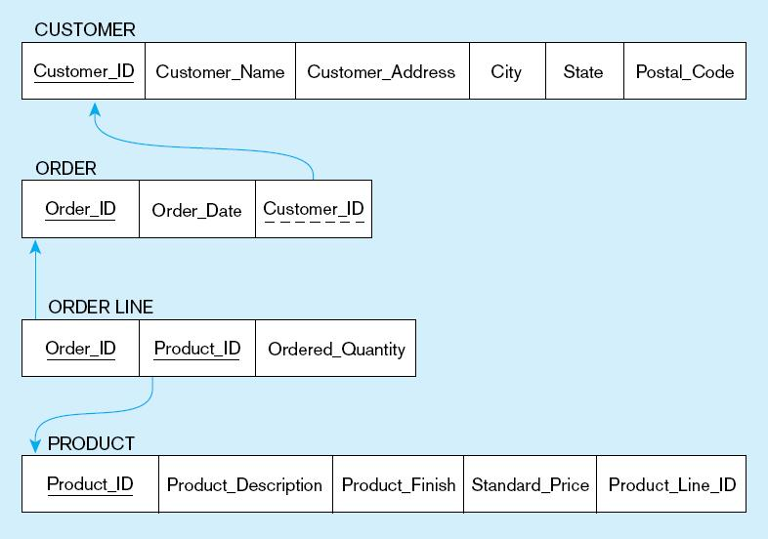
Figure 5-5
Referential integrity constraints (Pine Valley Furniture)
Referential integrity constraints are drawn via arrows from dependent to parent table
Notes:
Referential Integrity

Slide 17
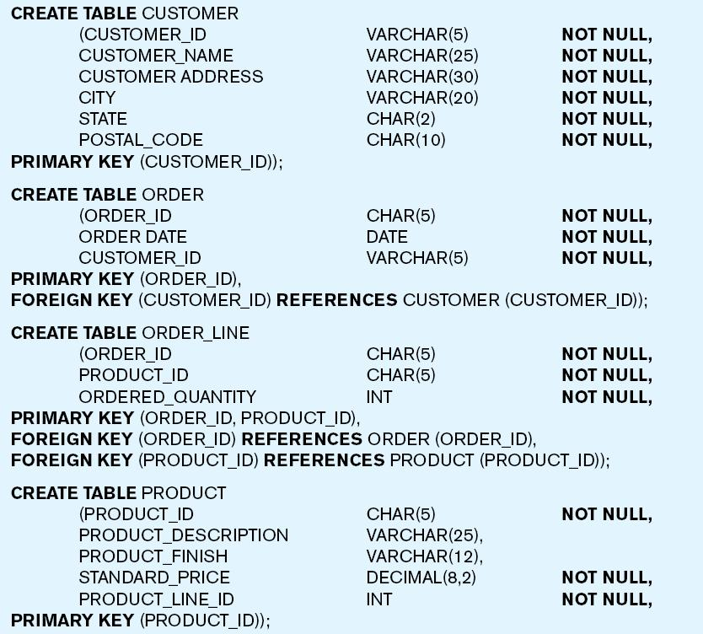
Figure 5-6 SQL table definitions
Referential integrity constraints are implemented with foreign key to primary key references
Notes:
Example on how you create a table using SQL language

Slide 18
Concept Check
1) A form of database design which maps conceptual requirements is called:
A) logical designs.
B) response designs.
C) security design.
D) physical design.
2) Data is represented in the form of:
A) data trees.
B) tables.
C) data notes.
D) chairs.
3________ is a component of the relational data model included to specify business rules to maintain the integrity of data when they are manipulated.
A) Business rule constraint
B) Data integrity
C) Business integrity
D) Data structure
Notes:
A
B
B

Slide 19
An attribute in a relation of a database that serves as the primary key of another relation in the same database is called a:
A) link attribute.
B) link key.
C) foreign key.
D) foreign attribute.
An attribute (or attributes) that uniquely identifies each row in a relation is called a:
A) column.
B) foreign field.
C) primary key.
D) duplicate key.
Notes:
C
C

Slide 20
Transforming E-R Diagrams into Relations
Mapping Regular Entities to Relations
Simple attributes: E-R attributes map directly onto the relation
Composite attributes: Use only their simple, component attributes
Multivalued Attribute: Becomes a separate relation with a foreign key taken from the superior entity

Slide 21

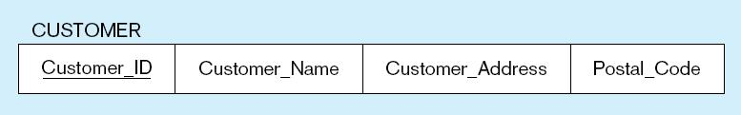
Figure 5-8 Mapping a regular entity
(a) CUSTOMER entity type with simple attributes
(b) CUSTOMER relation

Slide 22

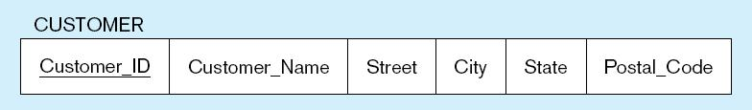
Figure 5-9 Mapping a composite attribute
(a) CUSTOMER entity type with composite attribute
(b) CUSTOMER relation with address detail

Slide 23

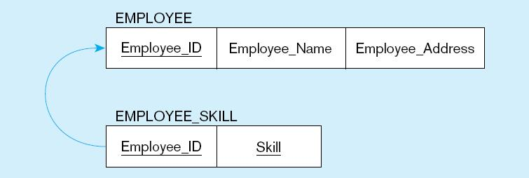
Figure 5-10 Mapping an entity with a multivalued attribute
(a)
Multivalued attribute becomes a separate relation with foreign key
(b)
One–to–many relationship between original entity and new relation

Slide 24
Transforming E-R Diagrams into Relations (cont.)
Mapping Weak Entities
Becomes a separate relation with a foreign key taken from the superior entity
Primary key composed of:
Partial identifier of weak entity
Primary key of identifying relation (strong entity)

Slide 25
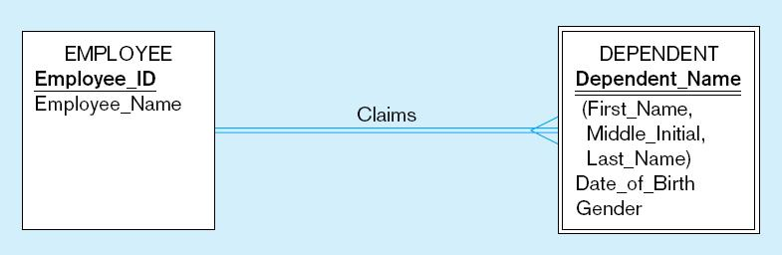
Figure 5-11 Example of mapping a weak entity
a) Weak entity DEPENDENT

Slide 26
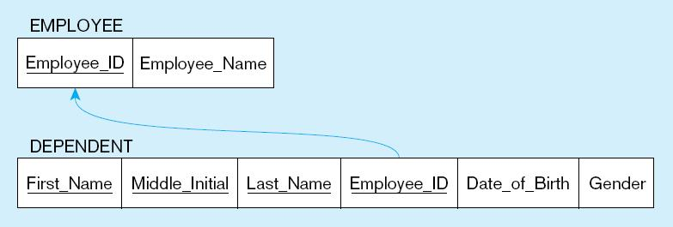
Figure 5-11 Example of mapping a weak entity (cont.)
b) Relations resulting from weak entity
NOTE: the domain constraint for the foreign key should NOT allow null value if DEPENDENT is a weak entity
Foreign key
Composite primary key
Notes:
Can the FK be NULL?

Slide 27
Transforming E-R Diagrams into Relations (cont.)
Mapping Binary Relationships
One-to-Many–Primary key on the one side becomes a foreign key on the many side
Many-to-Many–Create a new relation with the primary keys of the two entities as its primary key
One-to-One–Primary key on the mandatory side becomes a foreign key on the optional side

Slide 28
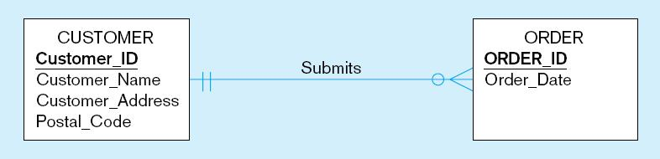
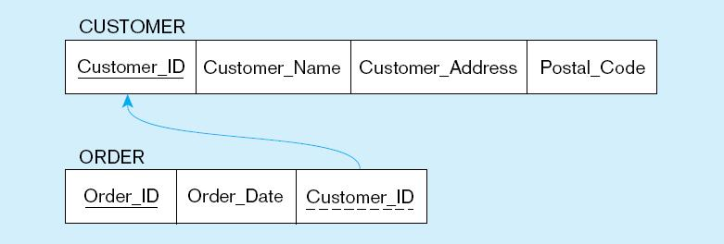
Figure 5-12 Example of mapping a 1:M relationship
a) Relationship between customers and orders
Note the mandatory one
b) Mapping the relationship
Again, no null value in the foreign key…this is because of the mandatory minimum cardinality
Foreign key

Slide 29
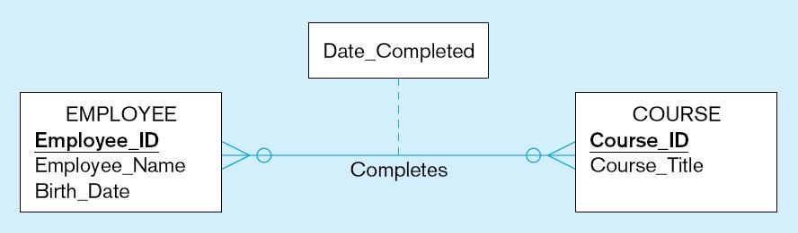
Figure 5-13 Example of mapping an M:N relationship
a) Completes relationship (M:N)
The Completes relationship will need to become a separate relation

Slide 30
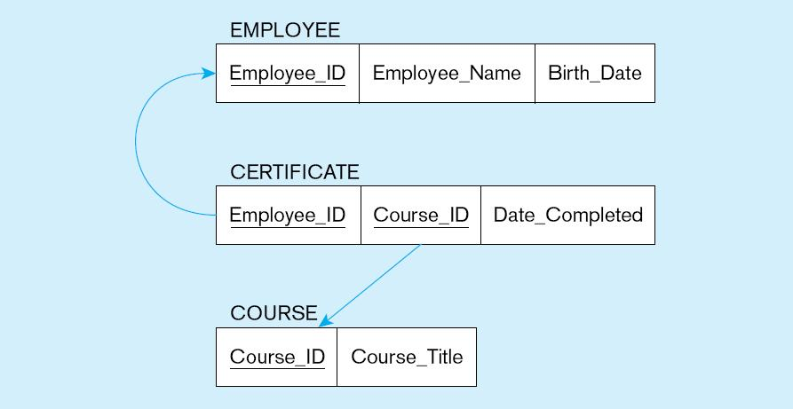
Figure 5-13 Example of mapping an M:N relationship (cont.)
b) Three resulting relations
Composite primary key
Foreign key
New intersection relation
Foreign key

Slide 31
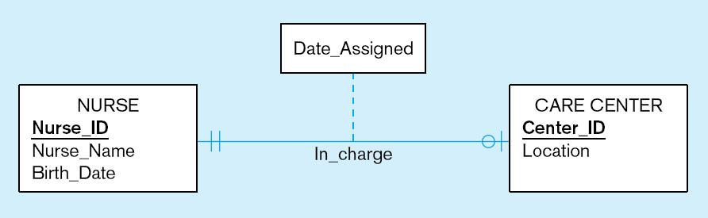
Figure 5-14 Example of mapping a binary 1:1 relationship
a) In_charge relationship (1:1)
Often in 1:1 relationships, one direction is optional

Slide 32
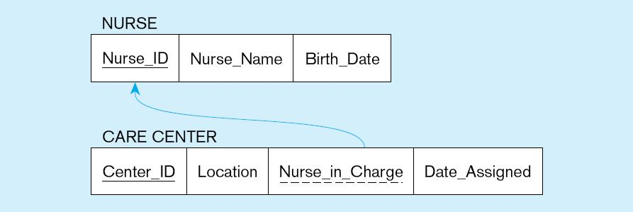
Figure 5-14 Example of mapping a binary 1:1 relationship (cont.)
b) Resulting relations
Foreign key goes in the relation on the optional side,
matching the primary key on the mandatory side

Slide 33
Transforming E-R Diagrams into Relations (cont.)
Mapping Associative Entities
Identifier Not Assigned
Default primary key for the association relation is composed of the primary keys of the two entities (as in M:N relationship)
Identifier Assigned
It is natural and familiar to end-users
Default identifier may not be unique
Notes:
Mapping an associative entities:
Primary key-> becomes a composite key of the two entities
When an identifier is assigned.-> use the identifier

Slide 34
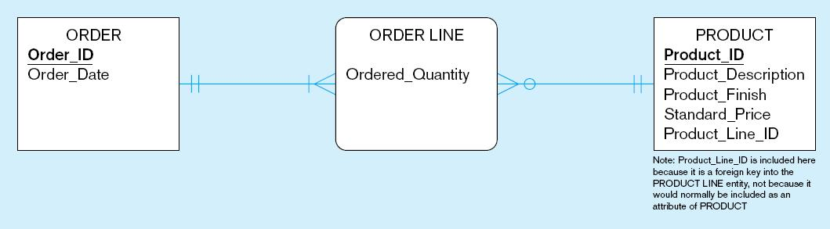
Figure 5-15 Example of mapping an associative entity
a) An associative entity

Slide 35
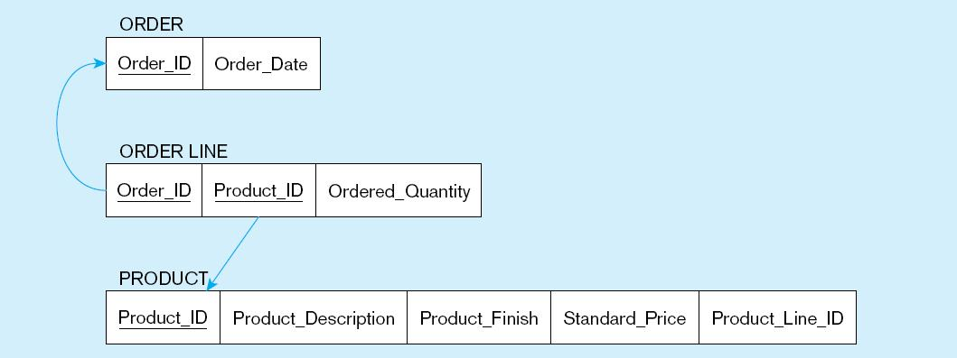
Figure 5-15 Example of mapping an associative entity (cont.)
b) Three resulting relations
Composite primary key formed from the two foreign keys

Slide 36
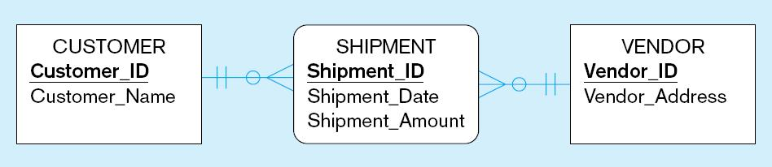
Figure 5-16 Example of mapping an associative entity with
an identifier
a) SHIPMENT associative entity

Slide 37
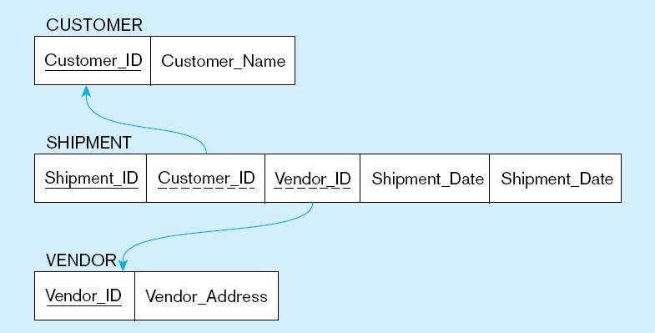
Figure 5-16 Example of mapping an associative entity with
an identifier (cont.)
b) Three resulting relations
Primary key differs from foreign keys

Slide 38
Transforming E-R Diagrams into Relations (cont.)
Mapping Unary Relationships
One-to-Many–Recursive foreign key in the same relation
Many-to-Many–Two relations:
One for the entity type
One for an associative relation in which the primary key has two attributes, both taken from the primary key of the entity

Slide 39
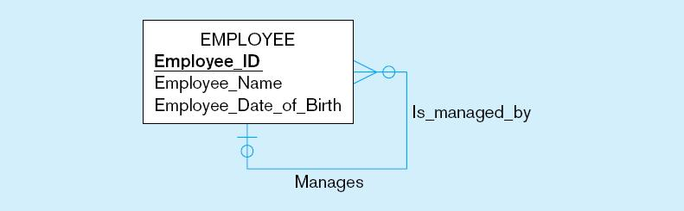
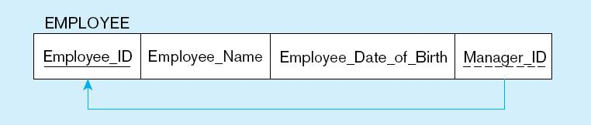
Figure 5-17 Mapping a unary 1:N relationship
(a) EMPLOYEE entity with unary relationship
(b) EMPLOYEE relation with recursive foreign key

Slide 40
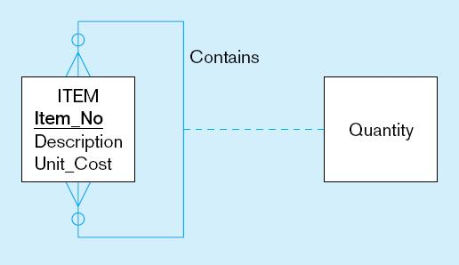
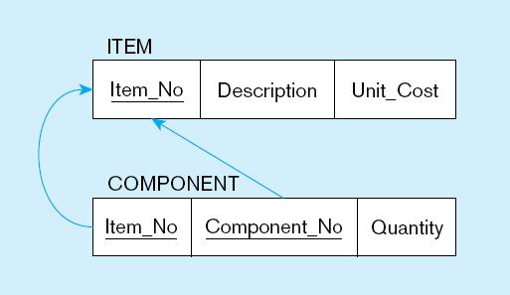
Figure 5-18 Mapping a unary M:N relationship
(a) Bill-of-materials relationships (M:N)
(b) ITEM and COMPONENT relations

Slide 41
Transforming E-R Diagrams into Relations (cont.)
Mapping Ternary (and n-ary) Relationships
One relation for each entity and one for the associative entity
Associative entity has foreign keys to each entity in the relationship
Notes:
Ternary
1 relation or table for one entity
1 relation for each associative entity

Slide 42
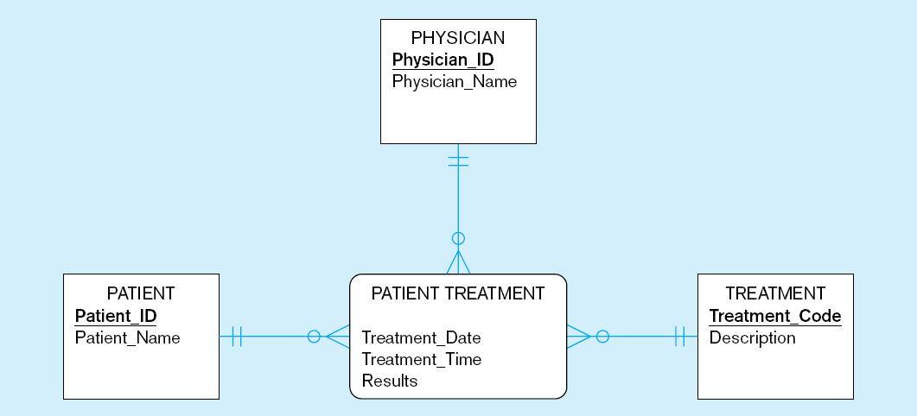
Figure 5-19 Mapping a ternary relationship
a) PATIENT TREATMENT Ternary relationship with associative entity

Slide 43
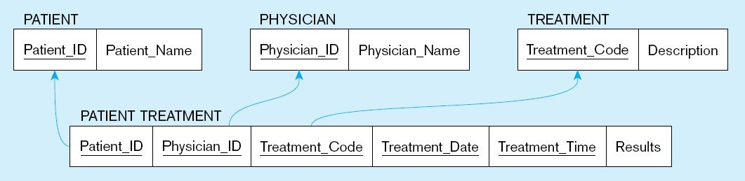
Figure 5-19 Mapping a ternary relationship (cont.)
b) Mapping the ternary relationship PATIENT TREATMENT
Remember that the primary key MUST be unique
This is why treatment date and time are included in the composite primary key
But this makes a very cumbersome key…
It would be better to create a surrogate key like Treatment#

Slide 44
Transforming EER Diagrams into Relations
Mapping Supertype/Subtype Relationships
One relation for supertype and for each subtype
Supertype attributes (including identifier and subtype discriminator) go into supertype relation
Subtype attributes go into each subtype; primary key of supertype relation also becomes primary key of subtype relation
1:1 relationship established between supertype and each subtype, with supertype as primary table
Notes:
Supertype/Subtype
1 relation for each supertype supbype
Supertype attribute for subtype descriminator

Slide 45
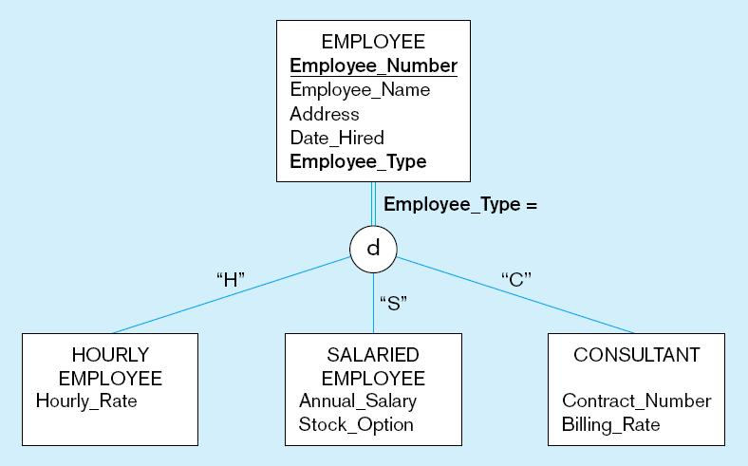
Figure 5-20 Supertype/subtype relationships

Slide 46
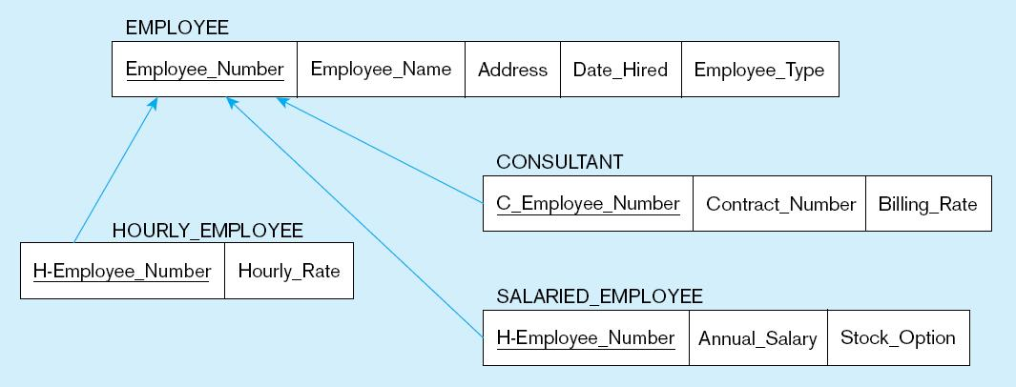
Figure 5-21
Mapping Supertype/subtype relationships to relations
These are implemented as one-to-one relationships

Slide 47
The entity integrity rule states that:
A) no primary key attribute can be null.
B) referential integrity must be maintained across all entities.
C) each entity must have a primary key.
D) a primary key must have only one attribute
Which of the following are properties of relations?
A) Each attribute has the same name.
B) No two rows in a relation are identical.
C) There are multivalued attributes in a relation.
D) All columns are numeric.
Notes:
A
b
b

Slide 48
1) When Mapping Binary Relationships perform the following
One-to-Many–Primary key on the one side becomes a foreign key on the many side
Many-to-Many–Create a new relation with the primary keys of the two entities as its primary
One-to-One–Primary key on the mandatory side becomes a foreign key on the optional side
All of the Above
2)When Mapping Ternary Relationships perform the following:
A)Merge similar entities into one and one for the associative entity
B) Associative entity has foreign keys to each entity in the relationship
C) Primary key on the mandatory side becomes a foreign key on the optional side
D) All of the Above
Notes:
D)
B)

